Slide 1


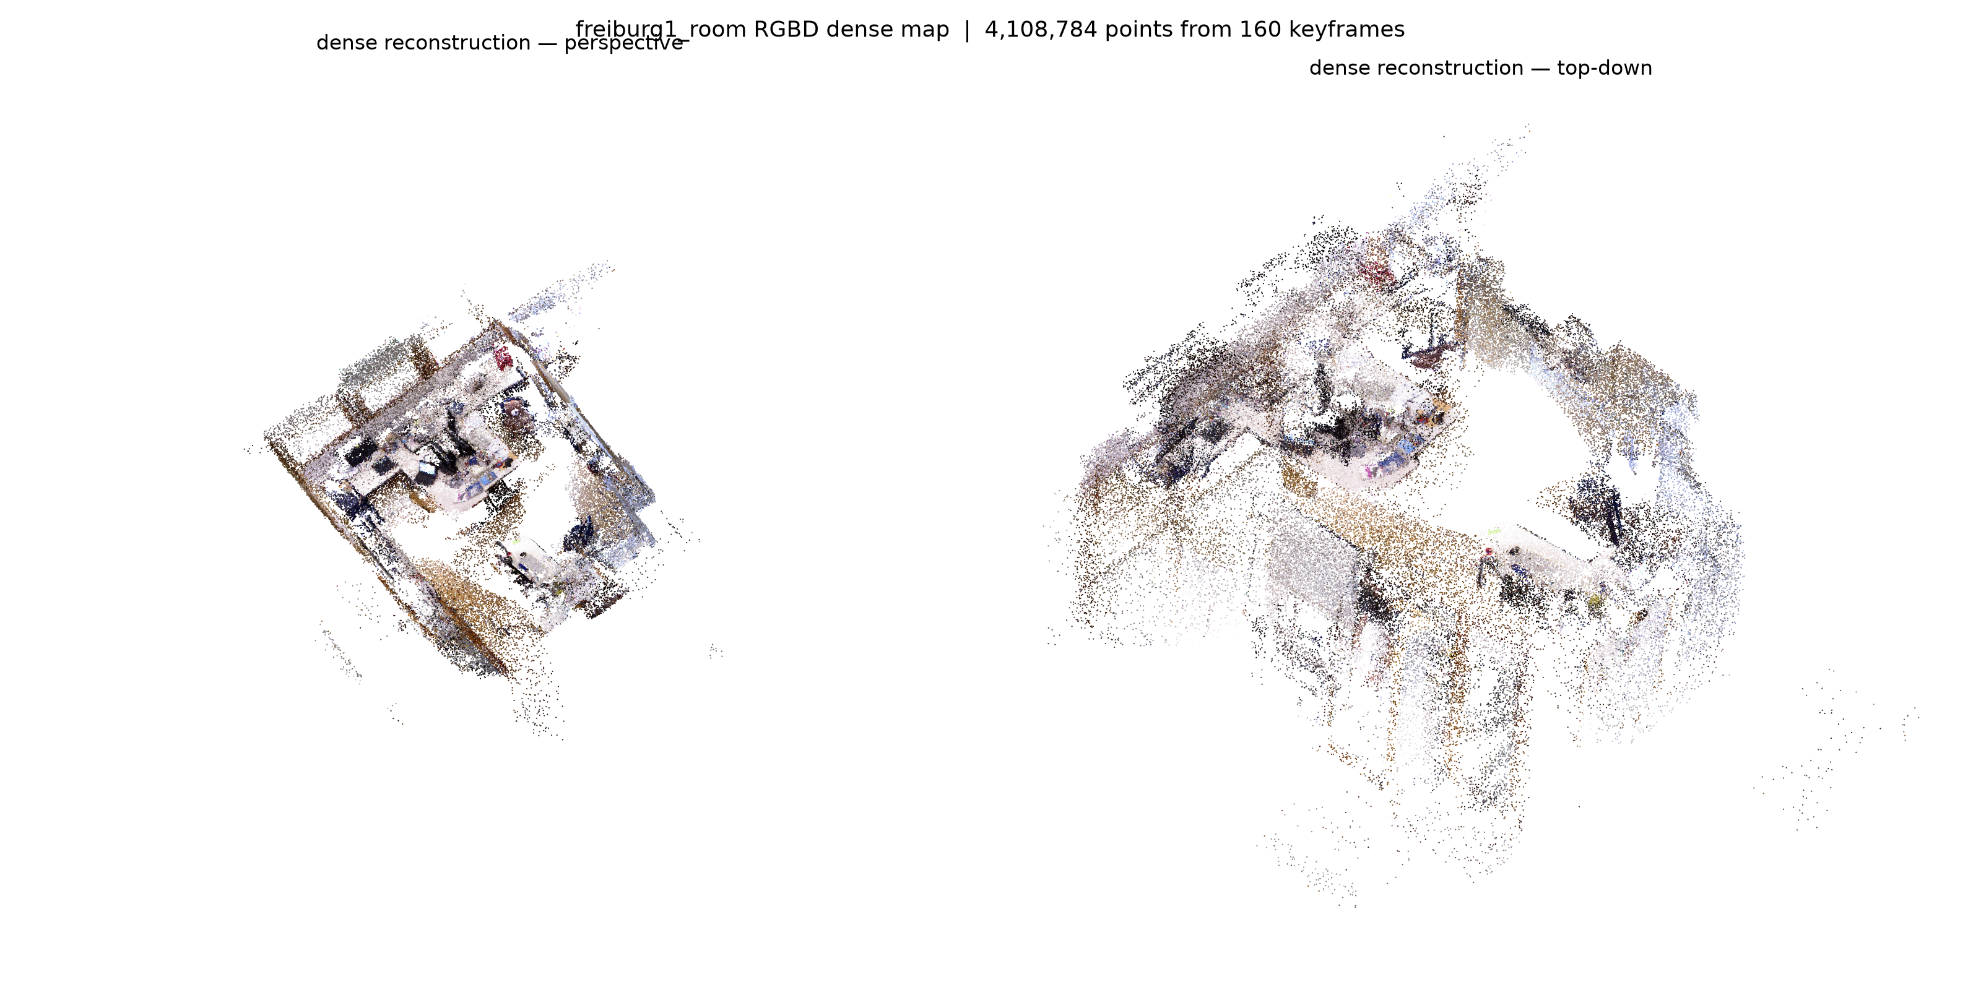
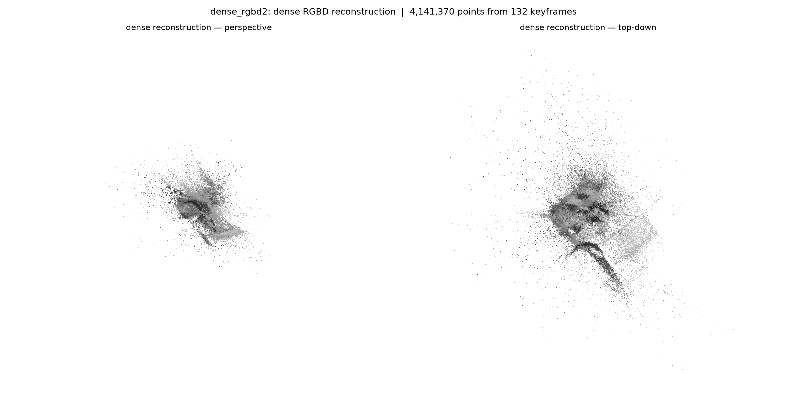
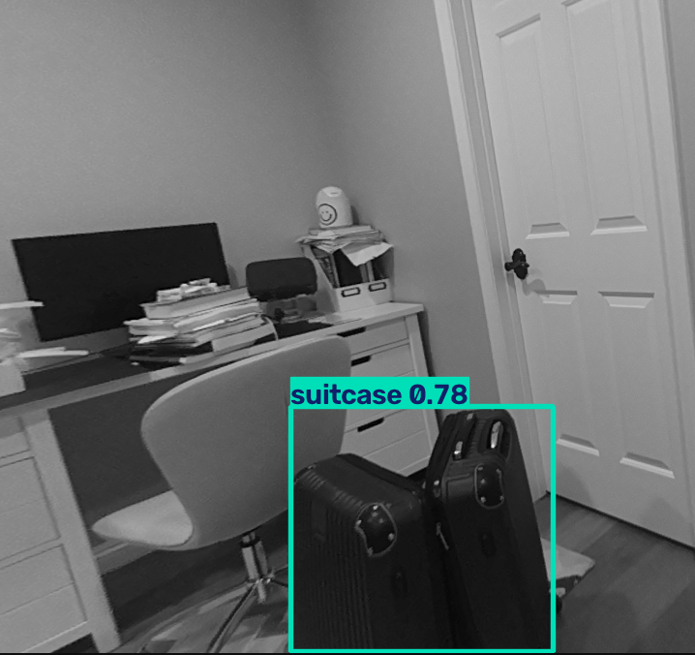
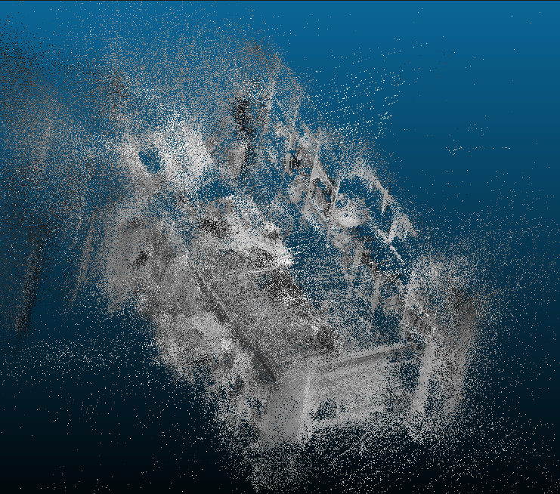
3-Dimensional/Space Analyses and Applications with Edge AI
Edge-Deployed Visual SLAM
3D Mapping with an OAK-D Camera on a Raspberry Pi 5
Authors: Saevin Hong, Aadi Jain, Kathleen Wang
Mentor: Dr. Jack Silberman, Lecturer, Jacobs School of Engineering, UCSD
Abstract
Project Evolution
Simultaneous Localization and Mapping (SLAM) lets a moving camera build a map of an unknown space while tracking its own position within it. Our team refactored ORB-SLAM3, a foundational state-of-the-art visual SLAM system, on low-cost edge hardware — a Luxonis OAK-D stereo-depth camera and a Raspberry Pi 5 — to explore real-time 3D mapping of indoor spaces. After evaluating it on a benchmark dataset (TUM-VI), we recorded several RGB-D footages and used ORB-SLAM3 to recreate the spaces.
SLAM System
Generating a sparse cloud map of room being scanned
Initially used IMU-Stereo for better resistance to drift, shifted focus to RGBD for ease of use and recording
CPU-intensive for live SLAM operation; compromised the system to reduce the CPU usage, but decreased map quality
Item Recognition
Final Project Proposal
Recognizing household objects and removing any dynamic objects
Trained an AI to recognize household and dynamic objects and running within the OAKD itself using public datasets. Later integrating with the SLAM pipeline
Creating an accurate, real-time spatial understanding is essential for autonomous systems to safely navigate and interact with their environment. By using our approach, we can increase access to SLAM by keeping it low-cost while delivering high-quality results.
Results
Methodology
Sparse Map Reconstruction
Hardware: OAK-D (stereo cameras + IMU + on-device depth) on a Raspberry Pi 5.
Software: ORB-SLAM3 and its related dependencies for collecting data and generating sparse maps. Used Docker to emulate the Pi's environment and ran datasets through it to test the SLAM system
Calibration: per-unit factory intrinsics/extrinsics and IMU noise parameters.
Detection: The YOLO26 model recognizes current household objects and remove dynamic objects from being integrated into the sparse map(e.g. people, suitcases, etc.)
Sequence | Frames | KFs | Sub-Maps | Map pts | Tracking recoveries
TUM freiburg1 | 1362 | 319 | 1 | 17.6k | 0
OAK-D rgbd1 | 2269 | 289 | 2 | 24.9k | 1 reset
OAK-D rgbd2 | 4311 | 606 | 1 | 28.3k | 13 (no reset)
OAK-D rgbd3 | 4745 | 276 | 1 | 16.8k | 0
Conclusion
Edge SLAM is feasible — ORB-SLAM3 runs on Raspberry-Pi-class hardware. Stereo-inertial is powerful and reduces errors but is fragile to initialization motion and various other recording constraints; RGB-D is more robust for dense mapping but loses the ability to map out larger buildings. Recording and motion quality matter as much as the algorithm for certain specific processes.
Dense reconstruction from RGB-D SLAM. Dataset: TUM-VI, freiburg1_room
Our data: dense reconstruction from OAK-D recording rgbd2
Future Works
Optimizations that SLAM can make to run more smoothly and prevent any backlog of tasks the CPU can't complete in time without compromising the map significantly.
Better distinction between dynamic objects, moving figures, and features of the room itself.
Colored dense reconstruction on OAK-D (align RGB stream to depth) + true volumetric fusion (TSDF) instead of point stacking
Loop closure and map merging to remove fragmentation (e.g. rgbd1's 2 sub-maps)
YOLO26 Model recognizes dynamic object suitcase (0.78 Confidence) to remove from sparse mapping in rgbd3
Colored and detailed sparse map of rgbd1 .ply file, with dynamic objects removed
Benchmark Error Analysis
Mode | Dataset | Trajectory Error
RGB-D (primary) | TUM freiburg1_xyz | 1.0 cm RMSE
IMU Stereo (early runs) | TUM-VI Room 1 | 1.2 cm RMSE
Acknowledgements
References
Special thanks to our mentor, Dr. Jack Silberman for his guidance during this program, Liz P for her helpful insight of our work, the REHS program for creating this amazing opportunity, and SDSC for providing the necessary materials. We'd also like to thank Team 5 and 6 for working in collaboration with us for this project.
Campos, C., Elvira, R., Gómez Rodríguez, J. J., Montiel, J. M. M., & Tardós, J. D. (n.d.). [2007.11898] orb-slam3: An accurate open-source library for visual, visual-inertial and multi-map slam. ORB-SLAM3: An Accurate Open-Source Library for Visual, Visual-Inertial and Multi-Map SLAM. https://arxiv.org/abs/2007.11898
Maity, S. (n.d.). Understanding Visual SLAM for Robotics Perception: Building Monocular SLAM from Scratch in Python OpenCV. https://learnopencv.com/monocular-slam-in-python/
Schubert, D., Demmel, N., & Usenko, V. (n.d.). Computer Vision Group - datasets - visual-inertial dataset. Visual-Inertial Dataset. https://cvg.cit.tum.de/data/datasets/visual-inertial-dataset

